Slide 1
Unsupervised Learning,
autoencoders,
and Deep Learning

Slide 2
k-Means
clusters data into k clusters as defined by centroids (prototypes) and a distance measure
not a tree, just one layer “deep”
iterative
can take a long time to converge for large data sets
Algorithm:
Select k random points m_{k} in the data space
Assign data points to closest m_{k}
Update m_{k} these to the centroid of the group
GIF from Wikipedia page on k-means

Slide 3
k-means in matlab (data generation)
>> xc=rand(1,3)
xc =
0.2785 0.5469 0.9575
>> yc=rand(1,3)
yc =
0.9649 0.1576 0.9706
>> sx1=.2*randn(25,1)+xc(1);
>> sx2=.4*randn(25,1)+xc(2);
>> sx3=.6*randn(25,1)+xc(3);
>> sy1=.2*randn(25,1)+yc(1);
>> sy2=.4*randn(25,1)+yc(2);
>> sy3=.6*randn(25,1)+yc(3);
>> scatter([sx1;sx2;sx3],[sy1;sy2;sy3])

Slide 4
k-means in matlab
>> opts = statset('Display','final');
[idx,C] = kmeans(X,3,'Distance','cityblock',...
'Replicates',5,'Options',opts);
Replicate 1, 7 iterations, total sum of distances = 40.1857.
Replicate 2, 7 iterations, total sum of distances = 43.7312.
Replicate 3, 4 iterations, total sum of distances = 40.2161.
Replicate 4, 4 iterations, total sum of distances = 39.8996.
Replicate 5, 6 iterations, total sum of distances = 38.5405.
Best total sum of distances = 38.5405
>> figure;
>> plot(X(idx==1,1),X(idx==1,2),'r.','MarkerSize',24)
>> hold on
>> plot(X(idx==2,1),X(idx==2,2),'b.','MarkerSize',24)
>> plot(X(idx==3,1),X(idx==3,2),'g.','MarkerSize',24)
>> scatter(xc,yc,400,'r','filled')
>> plot(C(:,1),C(:,2),'kx','MarkerSize',15,'LineWidth',3)

Slide 5
Voronoi Map
figure
gridd=[xg,yg];
reg=kmeans(gridd,3,'MaxIter',1,'Start',C)
gscatter(xg(:),yg(:),reg,[0,0.75,0.75;0.75,0,0.75;0.75,0.75,0],'..');
hold on
scatter(xc,yc,400,'r','filled')
plot(C(:,1),C(:,2),'kx','MarkerSize',15,'LineWidth',3)

Slide 6
Heirarchical Clustering
generates a binary tree that organizes data based on distance (or similarity) measures
begin with a matrix of all pairwise distances
cluster the closest items together, and enter the cluster as an item
iterate

Slide 7
Example
( ( A,B ), ( C, ( D,E ) ) )
10
8
6
4
2
0
A
B
C
D
E
 | A | B | C | D
B | 1.8
C | 8.1 | 8.4
D | 8.1 | 6.5 | 8.9
E | 8.6 | 7.6 | 5.7 | 4.0
 | C | D | E
D | 8.9
E | 5.7 | 4.0
F | 8.2 | 7.3 | 8.1
 | C | F
F | 8.2
G | 7.2 | 7.4
 | G
H | 7.6

Slide 8
Hierarchical Clustering in MATLAB
pdist.m gets distances
squareform.m puts pdist result into matrix form
linkage.m computes the tree parameters
dendrogram.m renders the tree using results from linkage

Slide 9
matlab example
>> m=squareform(ans)
m =
0 1.4142 6.4031 6.0828 6.0828
1.4142 0 6.7082 5.0000 5.3852
6.4031 6.7082 0 6.3246 4.4721
6.0828 5.0000 6.3246 0 2.0000
6.0828 5.3852 4.4721 2.0000 0
>> ml=linkage(m)
ml =
1.0000 2.0000 2.3984
4.0000 5.0000 3.4029
3.0000 7.0000 7.7817
6.0000 8.0000 9.1325
>> dendrogram(ml)
>> d=[[5 0];[6 1];[0 4];[6 6];[4 6]] ;
>> scatter(d(:,1),d(:,2),400,'r','filled')
>> pdist(d) ;
ans =
Columns 1 through 9
1.4142 6.4031 6.0828 6.0828 6.7082 5.0000 5.3852 6.3246 4.4721
Column 10
2.0000

Slide 10
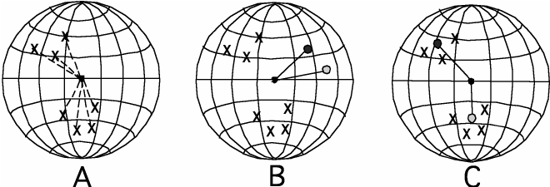
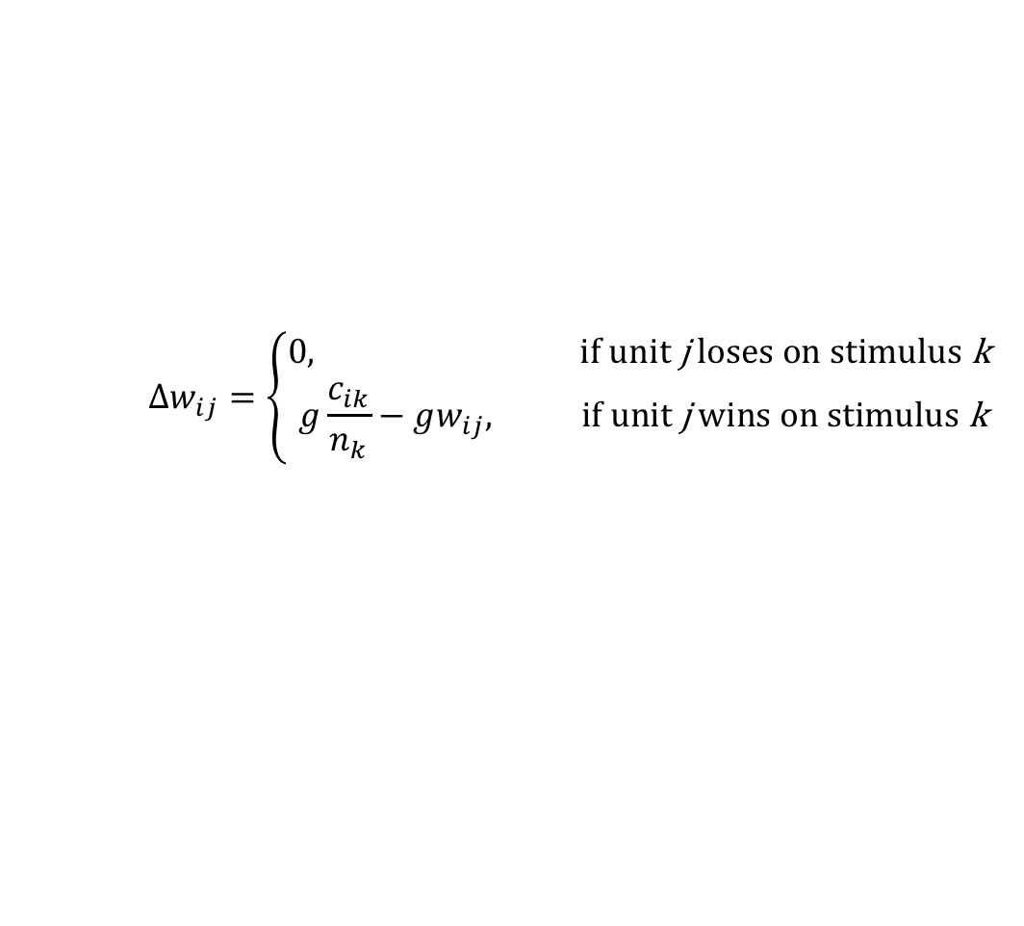
Competitive Learning
Δwij = g cik − gwij if unit j wins on stimulus k, otherwise Δwij = 0.
$$∆w_{ij}=\left\{\begin{aligned}0, \text{if} \text{unit} \text{j} \text{loses} \text{on} \text{stimulus} \text{k} \\ &g\frac{c_{ik}}{n_{k}}−gw_{ij}, \text{if} \text{unit} \text{j} \text{wins} \text{on} \text{stimulus} \text{k}\end{aligned}\right.$$

Slide 11
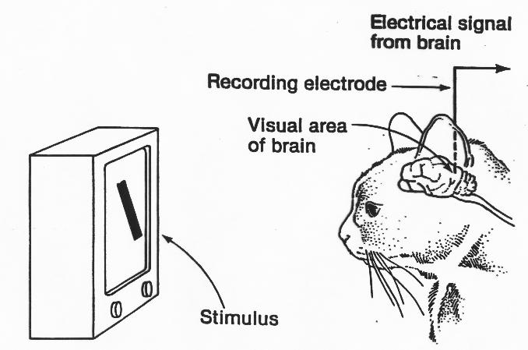
Single-Neuron Physiology

Slide 12
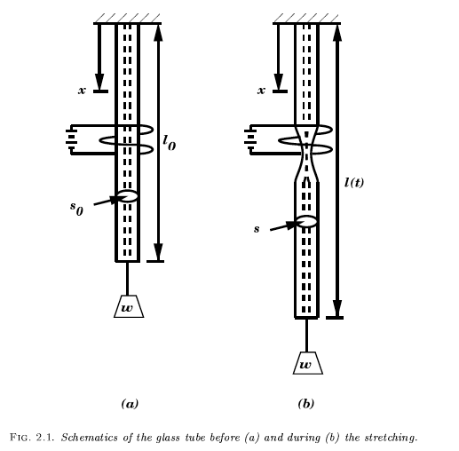
The intracellular electrode
by heating a narrow glass with a hot coil to soften the glass and attaching a small weight to one end, the tube can be pulled to a fine tip with a very narrow aperture. The tip can be inserted into a single neuron in the brain of a living, awake (but typically anesthetized) animal
Kuffler was among the first to use the technique to study the response properties of the ganglion cells ion the retina.

Slide 13
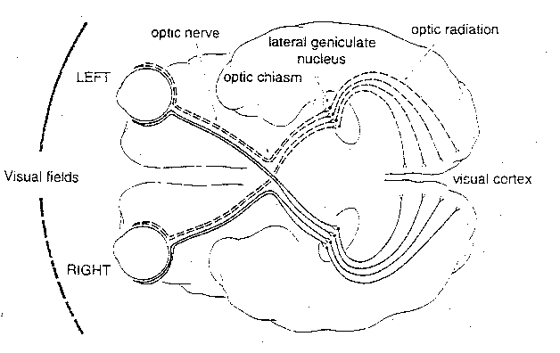
Visual retino-cortical pathway

Slide 14
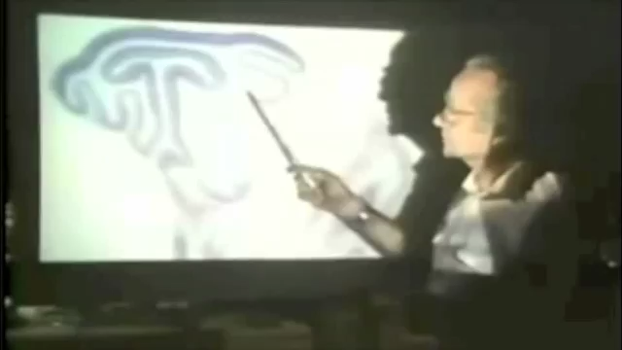
Hubel & Wiesel Orientation selective cells

Slide 15
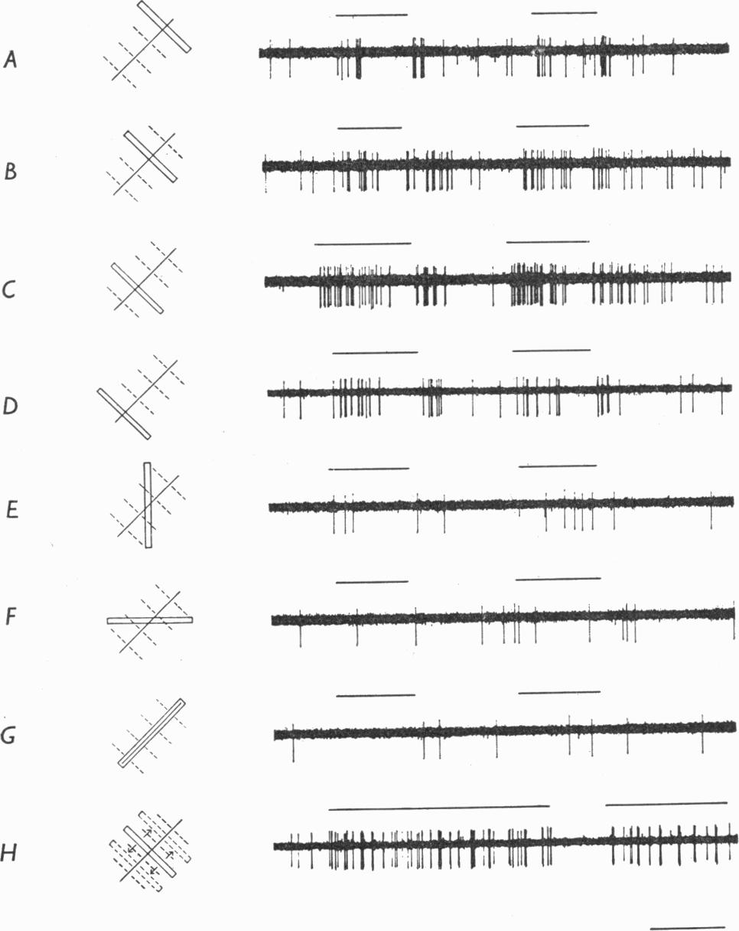
Orientation-selective cells
Hubel & Wiesel (1962):
neuron sensitive to orientation
some neurons respond to both eyes equally, some prefer one eye, and some respond only to one eye or the other
there is a topography across cortex with respect to visual field and to orientation

Slide 16
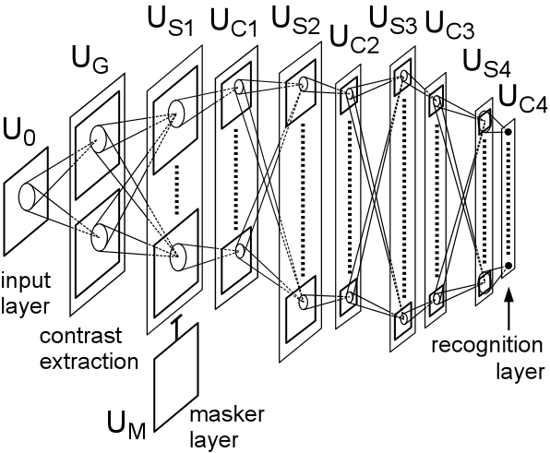
Neocognitron – Fukushima (1980)

Slide 17
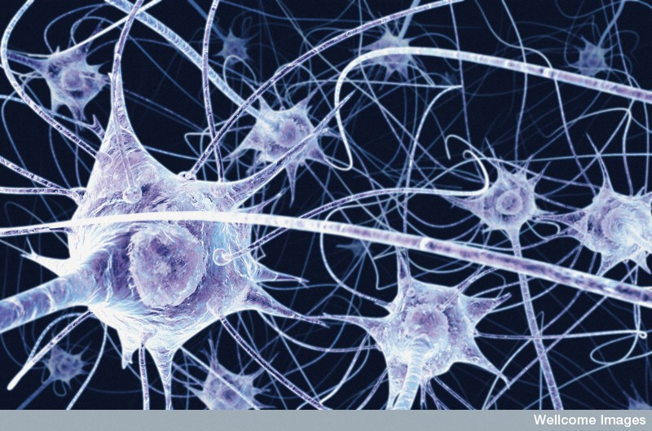
Plasticity in visual cortex
Newborn kittens do not show orientation selectivity
Monocular deprivation leads to monocularly responsive neurons
Binocularly deprived kittens retain binocular responsiveness but do not develop selectivity
Uncorrelated input can lead to monocular or binocular responsivity with different preferred stimuli

Slide 18
Bienenstock Cooper Munro (1982)
assume very simple (linear) processing unit:
in search of a hebb-like rule that accounts for development of selectivity

Slide 19
changing weights parallel to stimulus
if the change in weight space is in the direction of a specific vector v , response properties change most dramatically for stimuli parallel to v:

Slide 20
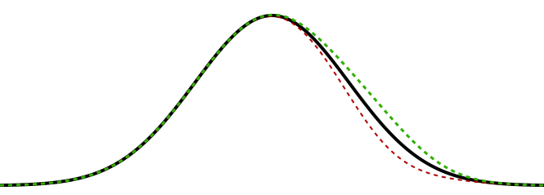
changing weights changes the response curve

Slide 21
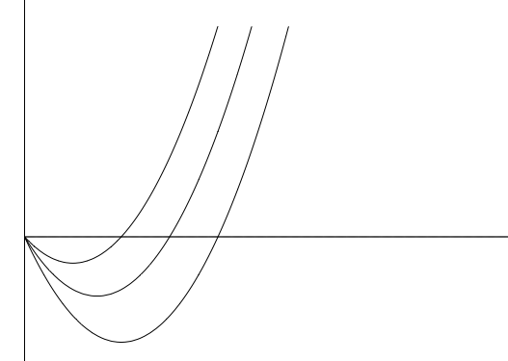
The BCM Rule

Slide 22
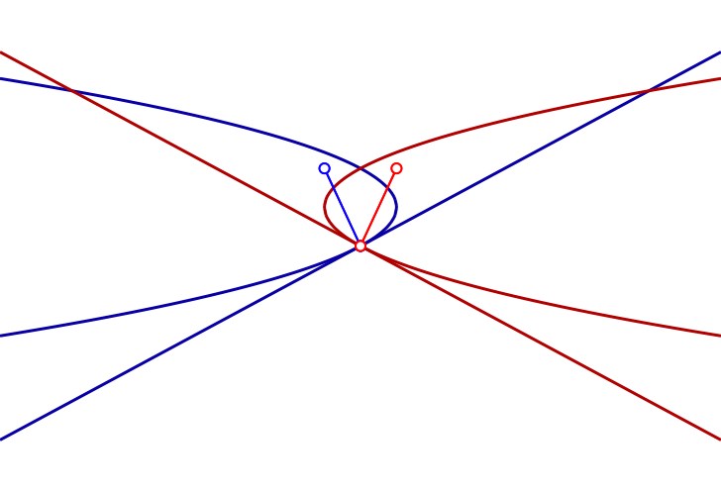
Weight Space

Slide 23
BCM in Matlab
>> p3data=.7*ones(3)+.3*eye(3)
p3data =
1.0000 0.7000 0.7000
0.7000 1.0000 0.7000
0.7000 0.7000 1.0000
>> p3data=normc(p3data)
p3data =
0.7107 0.4975 0.4975
0.4975 0.7107 0.4975
0.4975 0.4975 0.7107
>> p3data'*p3data
ans =
1.0000 0.9545 0.9545
0.9545 1.0000 0.9545
0.9545 0.9545 1.0000
>> b0=initorigbcm(3,2,123)
b0 =
struct with fields:
wts: [0.3929 -0.4277 -0.5463]
rb: 0
>> bf=origbcm(b0,p3data,100000,.005,123)
bf =
struct with fields:
wts: [29.9014 -12.3123 -12.3123]
rb: 3.0000
>> bf.wts*p3data
ans =
9.0000 0.0000 0.0000
function babynet = initorigbcm( nin,range,rs )
%initialize bcm cell
rng(rs);
babynet.wts=range*(rand(1,nin)-0.5) ;
babynet.rb = 0 ;
end
function finalcell = origbcm( initcell, pset, niter, dt, rs )
%iterates iterbcm
cell=initcell;
avgpat=sum(pset,2)/size(pset,2);
rng(rs) ;
for i=1:niter
apat = pset(:,irand(size(pset,2),1)) ;
r=cell.wts*apat ;
cell.rb = cell.wts*avgpat ;
cell.wts = cell.wts + dt*r*(r-cell.rb*cell.rb)*apat' ;
end
finalcell=cell;
end

Slide 24
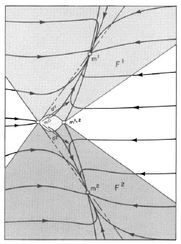
2-D state space graph

Slide 25
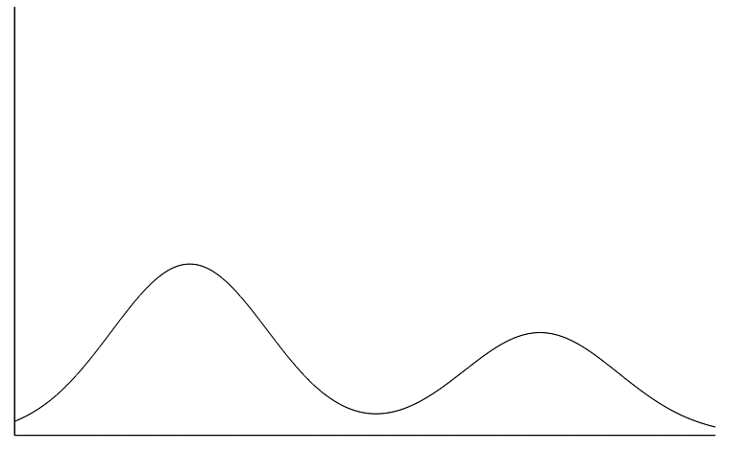
How it works

Slide 26
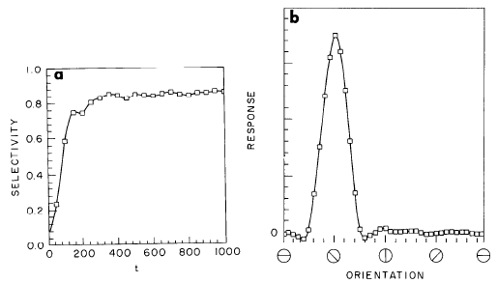
Achieves High Selectivity

Slide 27
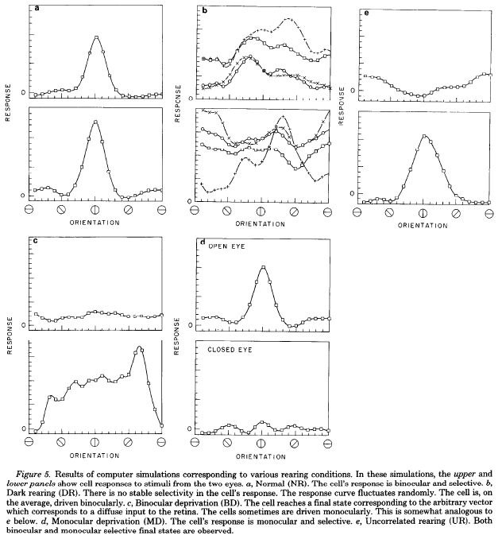
Visual Cortex Simulation

Slide 28
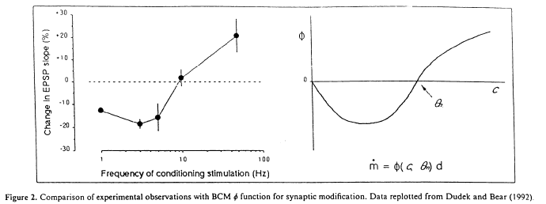
Experimental Verification (Dudek & Bear, 1992)

Slide 29
Experimental Verification (Dudek & Bear, 1992)

Slide 30
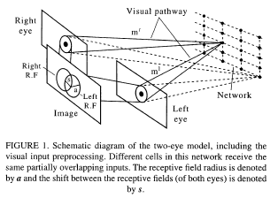
Application of BCM to realistic visual input

Slide 31
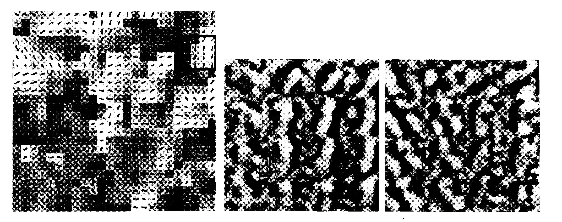
Similar to cortical organization

